Slide 1
Poster for Education AND LITERACY RATE IN TELANGANA ( RURAL AND URBAN )

Slide 2



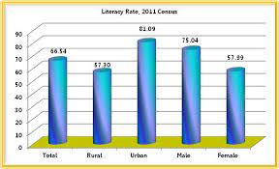
LITERACY RaTE IN TELANGANA ( RURAL AND URBAN )

